Slide 1
Predicting Student Exam Performance and Providing Actionable Study Recommendations
Odin, Jack, and Rafa
MCS-382 Final Project
Notes:
Odin

Slide 2
Introduction
Goals:
Predict exam scores using Machine Learning (ML) models.
Provide feedback to improve study performance
Importance:
Students, guiding their focus and efforts
Educators, identifying factors that influence success
Interventions
Contribution:
Model comparison (Ridge Regression, Random Forest, XGBoost, Gradient Boosting, MLP).
Identified critical factors that influence exam scores.
Interactive tools for percentile prediction and study strategies
Ridge Regression
Notes:
Odin

Slide 3
Related Work
Several studies have explored machine learning for predicting student performance:
Yağci (2022):
Predicted student performance using Random Forest, k-NN, SVM, Logistic Regression, and Naive Bayes on midterm grades.
Accuracy ranged between 70-75% due to limited features (only three predictors).
Our approach uses more variables like attendance and extracurricular activities for improved accuracy.
Ojajuni (2021):
Used Random Forest, Decision Trees, SVM, and XGBoost on high school data.
Found attendance and study habits as critical predictors.
XGBoost achieved 97.12% accuracy, showing its effectiveness in regression tasks.
Notes:
Odin

Slide 4
Related Work
3. Dervenis (2022):
Applied ML to a dataset with 30 variables (socioeconomic background, study habits, past grades).
Target was a 5-class classification problem instead of regression.
Despite differences, the study reinforces that ML models provide valuable insights for educators.
General Findings:
Features like attendance, study hours, and engagement consistently emerge as top predictors for high exam score.
While methods like Random Forest and XGBoost excel, linear models can also perform well, especially with structured data.
Notes:
Odin

Slide 5

Dataset & Evaluation Metrics
Dataset:
Name: Student Performance Factors.
Size: 6,607 rows, 20 features.
Source: Kaggle
Target: Exam_Score.
Features include attendance, study hours, resource access, sleep hours, etc.
Preprocessing:
Missing values imputed (mean).
Ordinal and one-hot encoding for categorical data.
Target standardized using StandardScaler.
Metrics:
MSE (Mean Squared Error): Measures error magnitude.
MAE (Mean Absolute Error): Interpretable absolute error.
R² Score: Explains variance captured by the model.

Slide 6
Methods
Models Used:
Ridge Regression
Random Forest
Gradient Boosting
XGBoost
MLP
Feature importance and user interaction:
np.abs(best_estimator.coef_) to get most influential features
Two functions that use the best performing model to calculate performance in class and combination of hours studied and attendance to reach performance goal.

Slide 7
Methods
Order:
Used simple version of the models
Got the results from that
Hypertuned parameters
Got the results from that
Used the best model to follow with feature importance and user interaction
Why Ridge Performed Best:
Linear relationships in data.
Simplicity and interpretability compared to complex models.

Slide 8
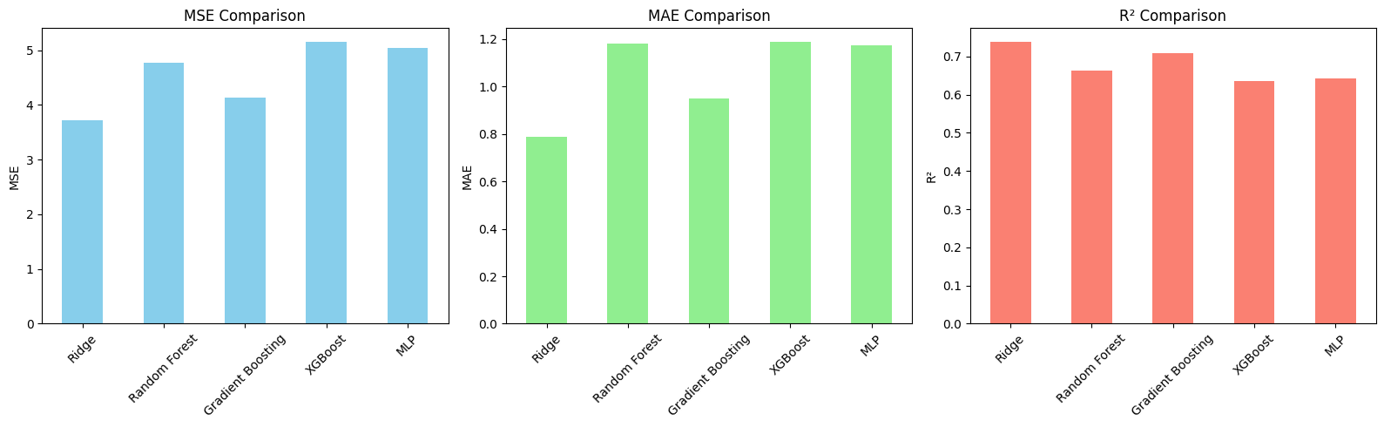
Results (Before Tuning)
Model | MSE | MAE | R²
Ridge | 3.71 | 0.79 | 0.737
Random Forest | 4.77 | 1.18 | 0.663
Gradient Boosting | 4.13 | 0.95 | 0.708
XGBoost | 5.14 | 1.19 | 0.636
MLP | 5.04 | 1.17 | 0.643

Slide 9
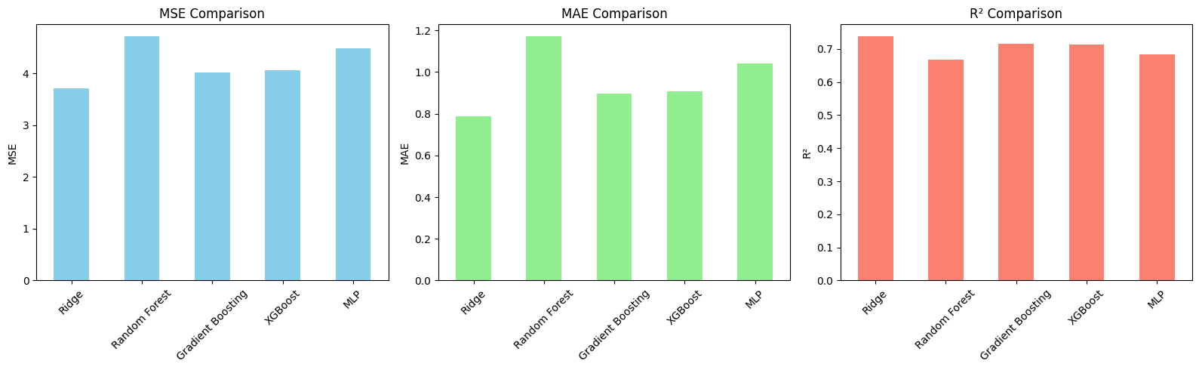
Results (After Tuning)
Model | MSE | MAE | R²
Ridge | 3.71 | 0.79 | 0.737
Random Forest | 4.71 | 1.17 | 0.667
Gradient Boosting | 4.03 | 0.90 | 0.715
XGBoost | 4.06 | 0.91 | 0.713
MLP | 4.48 | 1.04 | 0.683
Observation: Ridge Regression outperformed all others, achieving the lowest error and highest R² score.

Slide 10
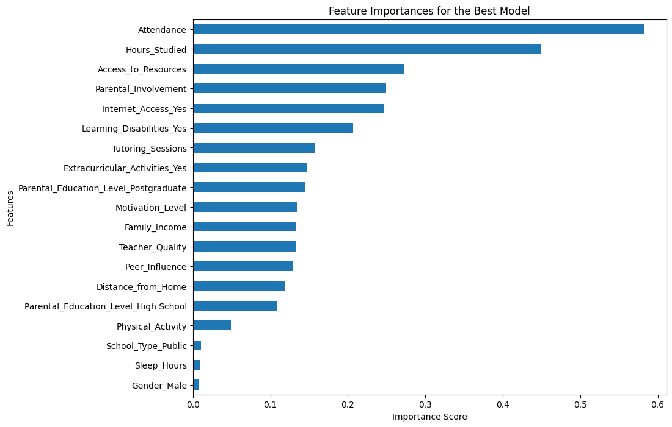
Feature Importance
Top 6 Features:
Attendance
Hours_Studied
Access_to_Resources
Parental_Involvement
Internet_Access
Learning_Disabilities

Slide 11
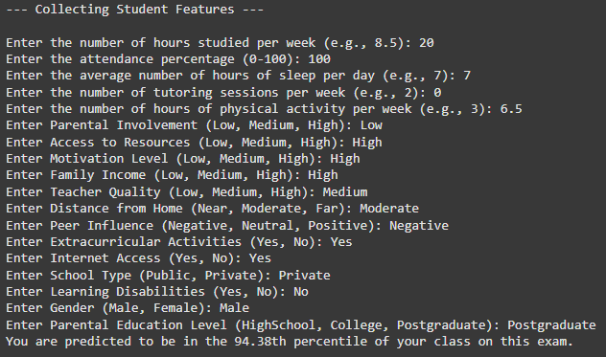
User Interaction Tools
Tool 1: Percentile Prediction
Input: Student features (e.g., hours studied, attendance, motivation).
Output: Predicted percentile.
Example:

Slide 12
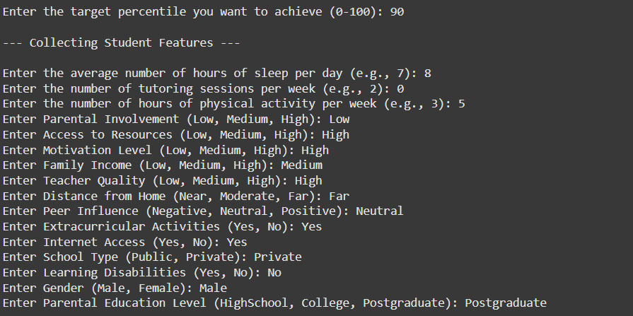
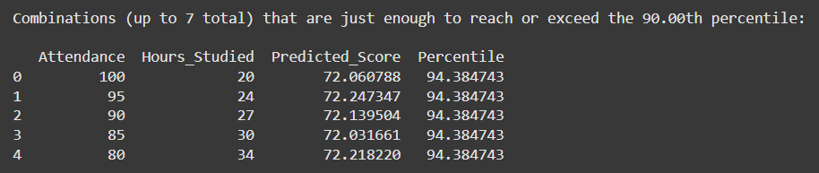
Tool 2: Target Percentile Guidance
Input: Desired percentile + current uncontrollable features.
Output: Study hours and attendance combinations.
Example:

Slide 13
Discussion
Surprise Findings:
Ridge Regression's linear nature captured relationships well, outperforming MLP and tree-based models.
Takeaways:
Attendance and hours studied are controllable and have the highest impact.
Different combinations of attendance and hours studied can get to the same grade
Limitations:
Few information about the source of the dataset
Performance in other datasets is unknown

Slide 14
Conclusion
Achievements:
Accurate predictions using Ridge Regression.
Tools for percentile prediction and actionable study advice.
Future Directions:
Adapt tools for different academic levels (High School, College) or for different Majors.
Explore advanced neural networks for larger datasets.
Improve user interface for broader adoption.

Slide 15


